Slide 1
COTTON CURATION
SOS 314
Allison MacDonell, Addison Bowlby
Andrea Chacon, Lucy Sanchez, Riley Forman

Slide 2
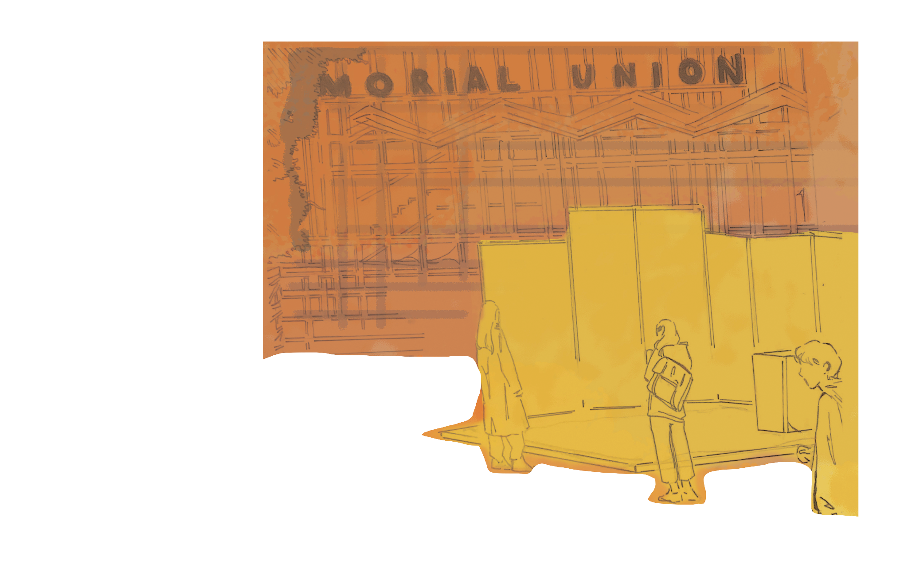
Why Cotton?
Displaying and bringing awareness to the life cycle of clothes and the materials and how much it travels before it is available to be purchased and worn.
Making the Map in a public space to allow the community to learn more about it and potentially help with it

Slide 3
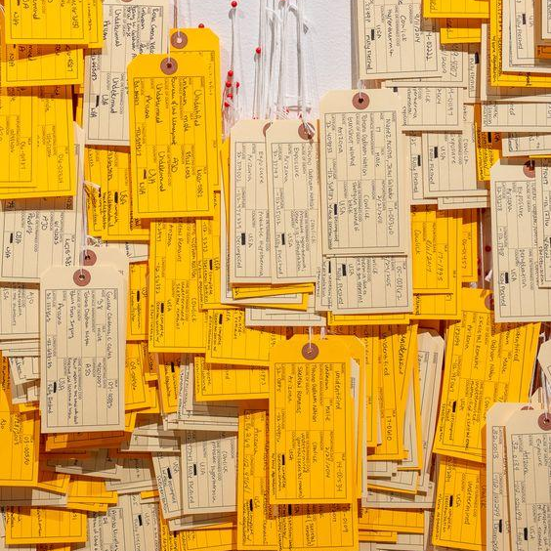
Breakdown
Approximately 450 million jeans are sold in the U.S each year with the global denim market valued at 59.2 billion
Sashin, Daphne, and Toby Lyles. “Blue Jeans Celebrate 140 Years.” CNN, Cable News Network, 20 May 2013, www.cnn.com/2013/05/20/living/blue-jeans-history-irpt/index.html.
Almost all the denim we wear—99.99 percent—is dyed with synthetic indigo. What is not publicized—what the apparel industry discreetly sidesteps—is that synthetic indigo is “made of ten chemicals—including petroleum, benzene, cyanide, formaldehyde—that are toxic or harmful to humans,”
Fashionopolis Ch 7

Slide 4
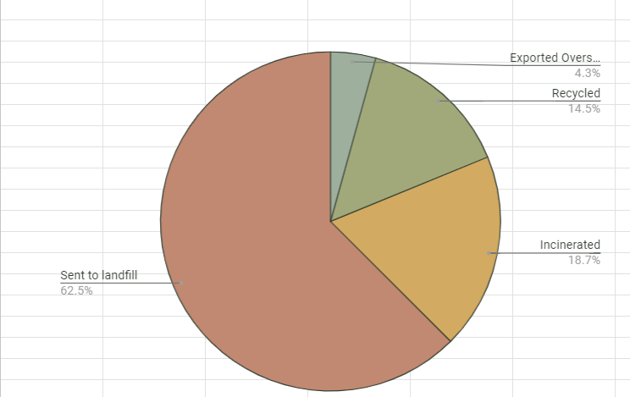
What happens to textile waste?
Exported Overseas
Recycled
Incinerated
Sent to Landfill
. For more info, click here

Slide 5
Materials Used in Installation
Pre-loved clothes | Second-hand jeans and various pre-loved cotton garments
Wooden Pallets | Free wooden pallets used as the baseboard of our installation
Staple Gun | The binding for the materials and palettes
Push Pins | Allows for an interactive element at the installation event
Various Colors of Yarn | Varying colors of yarn to tie the garment process across the map
For more info: https://www.levistrauss.com/wp-content/uploads/2020/01/2019_LSCO_WATER_STRATEGY_REPORT.pdf
Notes:
Finding materials that are free or well-sourced is critical to the projects authenticity and integrity. By selecting the materials through ethical means or freely available resources, the installation not only serves as the example of sustainability but also a blueprint for conscious consumption.

Slide 6
Construction
A combination of 6 wood pallets
Nails, staples, old jeans and shirts
Notes:
We began during the first week of April on the construction of our project after working through March on the research.

Slide 7
Installation Launch
Placed the installation in the back patio of Nash Vintage Collective in DT Mesa from 2pm to 6pm
Steady traffic throughout day

Slide 8
Conclusion
Key takeaway 1
Campaign objective
Partnering with local events that align with the same values we have
Bringing awareness to the life cycle of clothes
Key takeaway 2
Approach
Highlighting the unique qualities of our project/product or idea
Developed a comprehensive approach that addressed various aspects of the challenge
Utilized data analysis to inform decision-making
Notes:
Our impact was achieved through the conversations we were able to have with the attendants of the event as well as the understanding we gained through the process of building our installation.

