Slide 1
Waste Management
By Zach Dillon, Vonte Burse, Yihan Wang

Slide 2
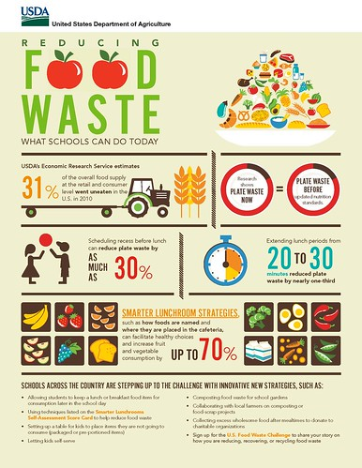
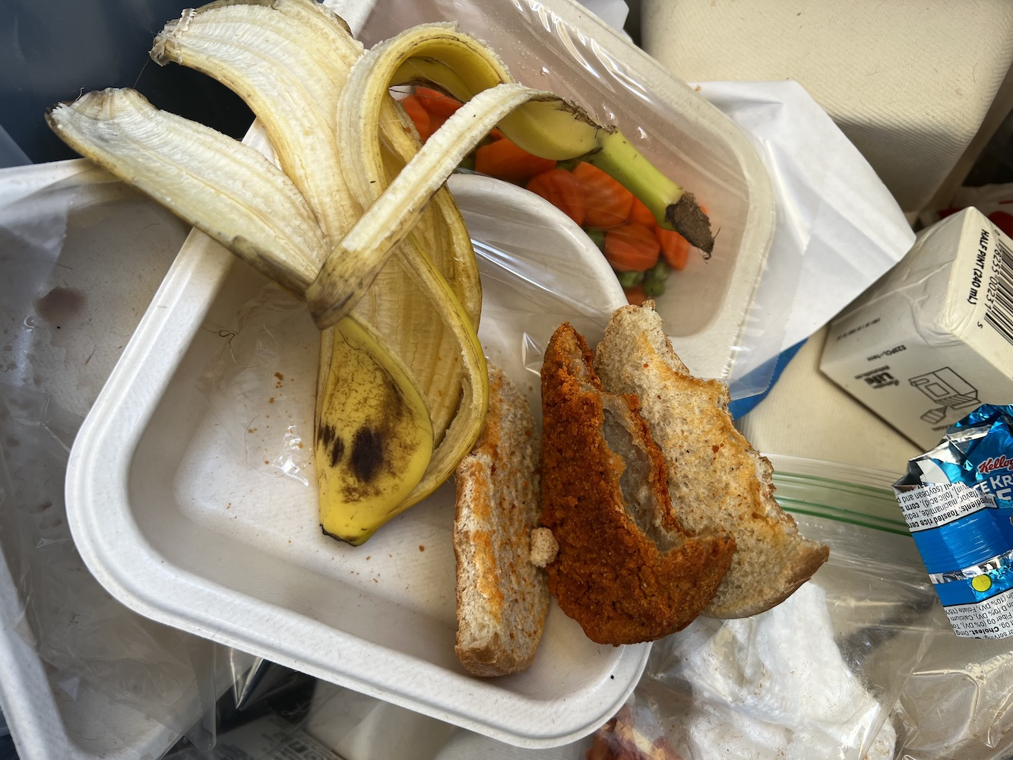
Food Waste

Slide 3
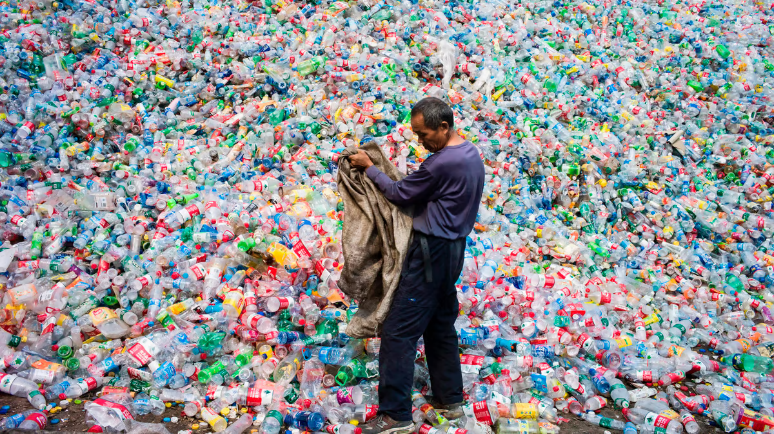
Waste

Slide 4
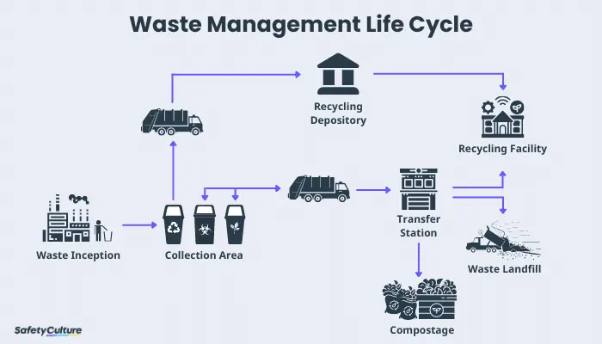

Slide 5
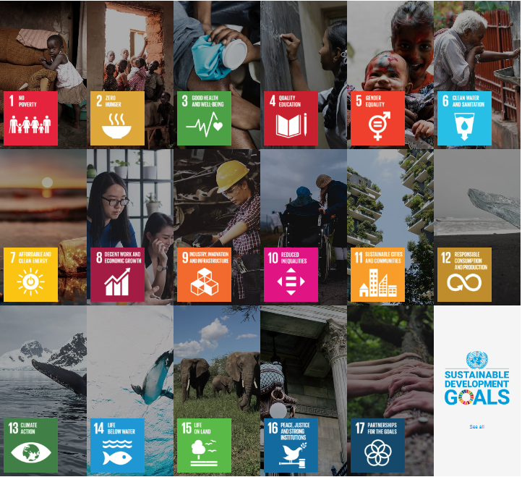
SDGs

Slide 6
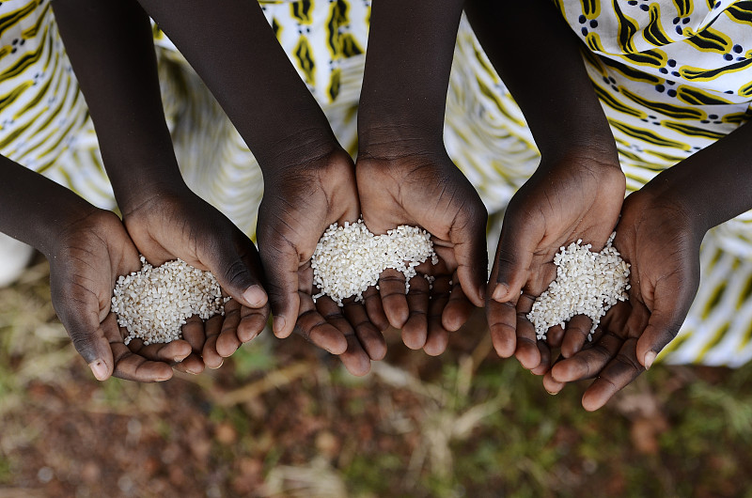
No Poverty No Hunger
About 80% of global wealth is owned by about 20% of the population
Job creation: The waste disposal industry can create employment opportunities, especially in impoverished areas.
Resource recycling and poverty alleviation: Garbage disposal can help alleviate poverty through resource recycling.
Environmental health and agricultural production: Proper waste disposal can help reduce environmental pollution and improve the quality of soil and water resources. This is crucial for agricultural production as they rely on clean soil and water sources to produce food. So as to change hunger

Slide 7
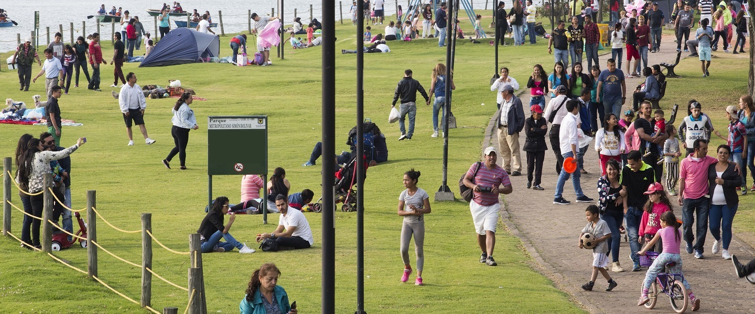
Sustainable cities and communities
According to research, approximately 30% to 50% of people worldwide consider sorting when throwing garbage.
Resource utilization and circular economy: Garbage treatment is a key link in achieving resource utilization and circular economy.Through garbage classification, recycling, and reuse, cities can reduce resource waste, extend the life cycle of resources, and reduce dependence on limited resources.
Environmental protection and public health: Effective garbage disposal helps to protect the environment and public health.
Community participation and awareness enhancement: Garbage disposal requires the participation and awareness enhancement of community residents.

Slide 8
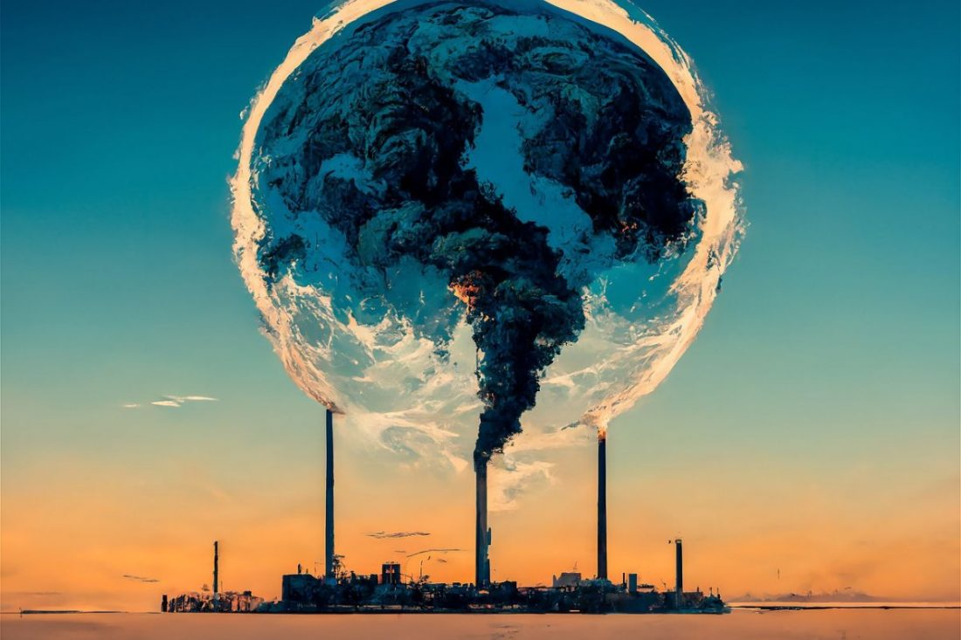
Climate action
Climate change leads to more frequent extreme weather events
Reducing greenhouse gas emissions: Greenhouse gases generated during waste disposal processes, such as methane and carbon dioxide, have a negative impact on climate change. By implementing effective waste treatment measures, such as composting of organic waste and controlling emissions from waste incineration, the emissions of these greenhouse gases can be reduced.
Energy recycling and utilization: Organic waste and combustible materials in garbage can be recycled and converted into energy, such as biogas or thermal energy generated by incineration. This type of energy recycling and utilization helps to reduce the demand for traditional energy and lower carbon emissions.
https://www.douyin.com/search/%E6%9A%B4%E9%A3%8E%E5%90%B9%E7%8E%BB%E7%92%83?aid=42dad15e-12a7-4798-8daa-13a5e3125d17&modal_id=7353100100467461403&type=general

Slide 9
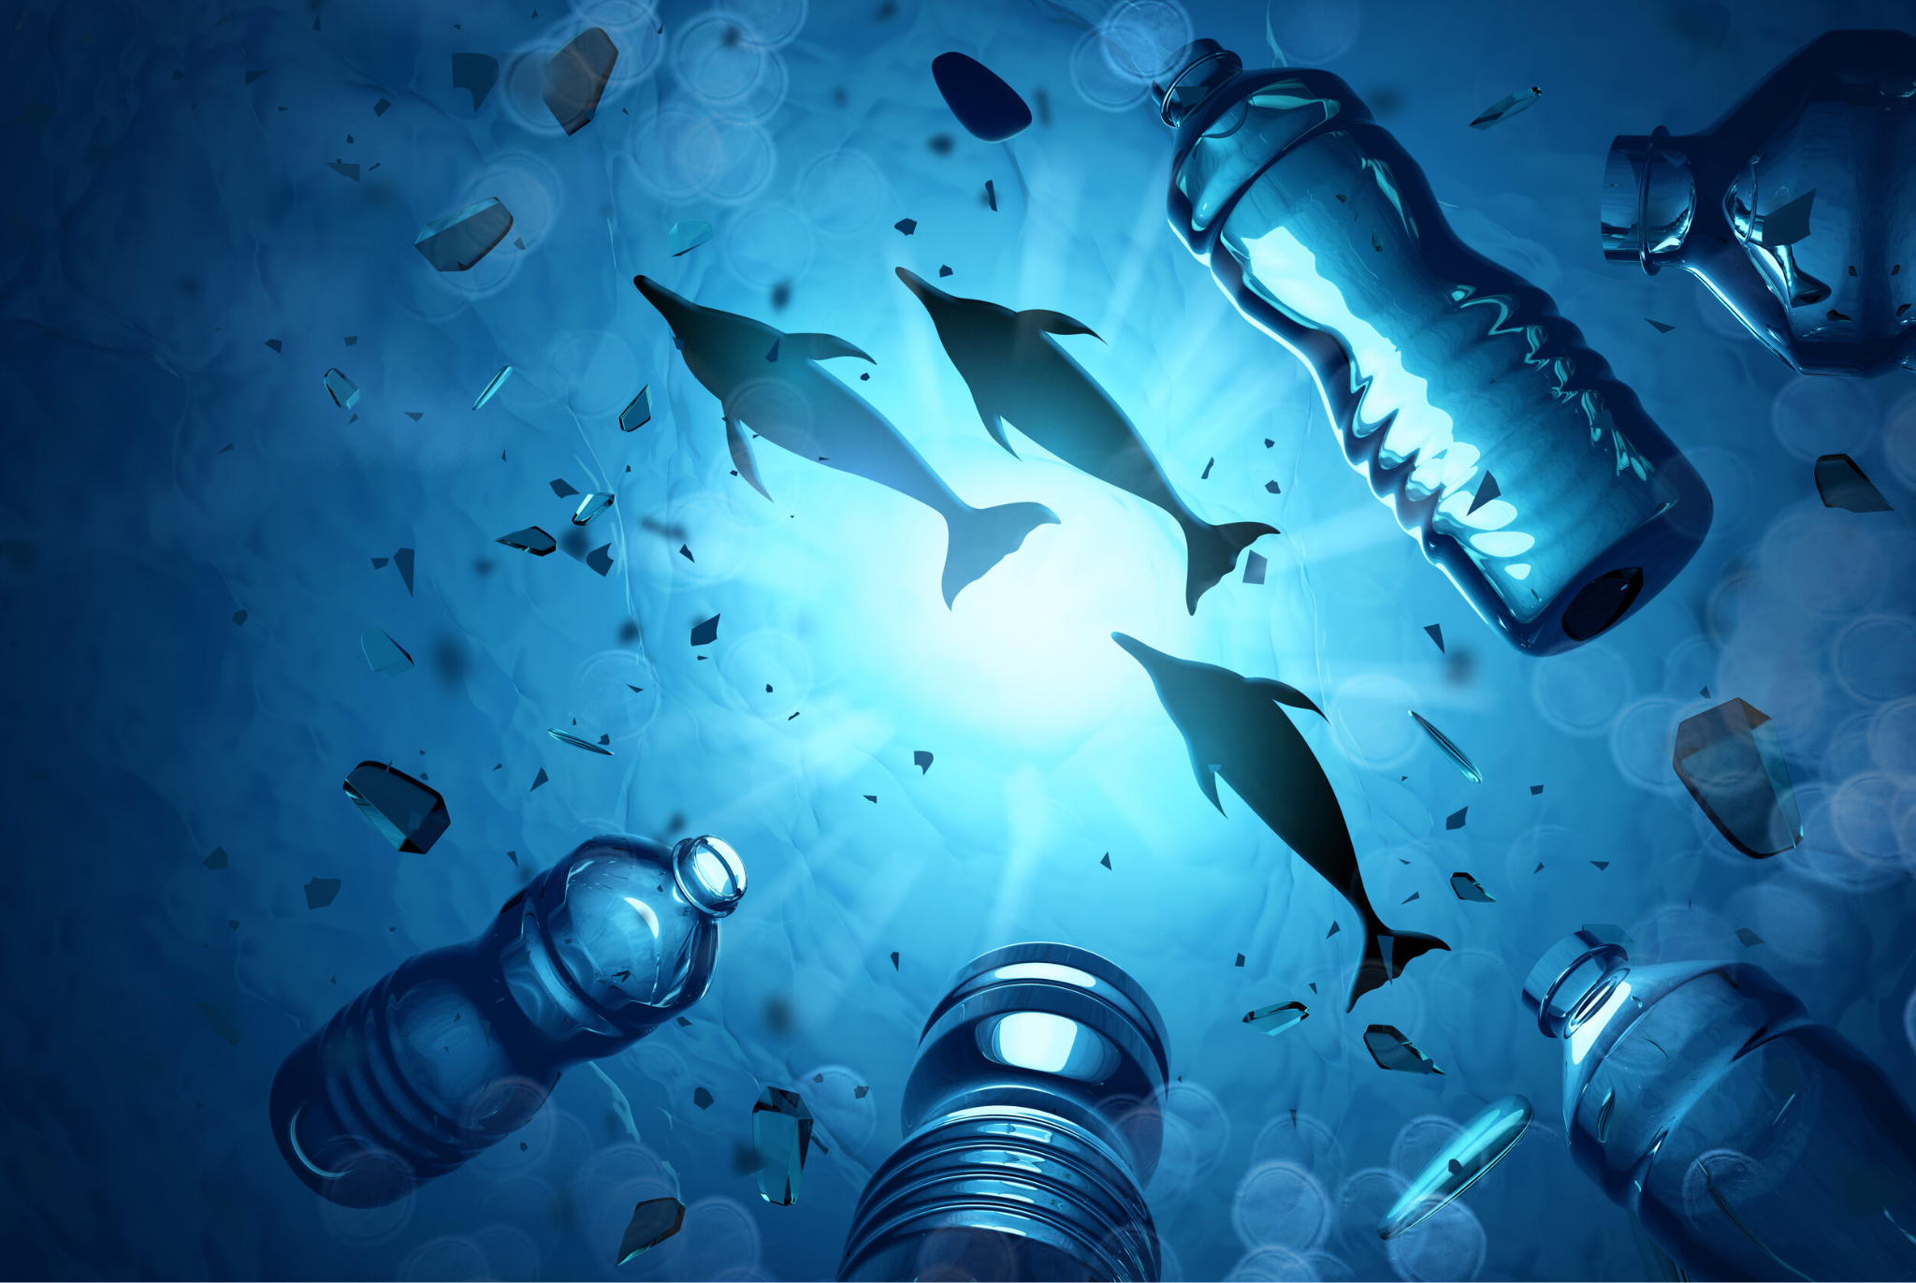
Life below water
Approximately 80% of the marine environment has not yet been explored by humans.
Marine pollution and garbage disposal: Improper garbage disposal may lead to marine pollution, including the entry of plastic waste, waste, and other pollutants into the ocean.
Marine Conservation: Marine debris poses a direct threat to marine life, such as turtles, whales, and seabirds that may accidentally ingest or entangle themselves in plastic debris, leading to death.
Marine resource protection: The ocean is an important source of resources, including food, energy, medicine, and other biological resources.
Environmental health and ecological balance: The health of marine ecosystems is crucial for the ecological balance of the Earth.

Slide 10
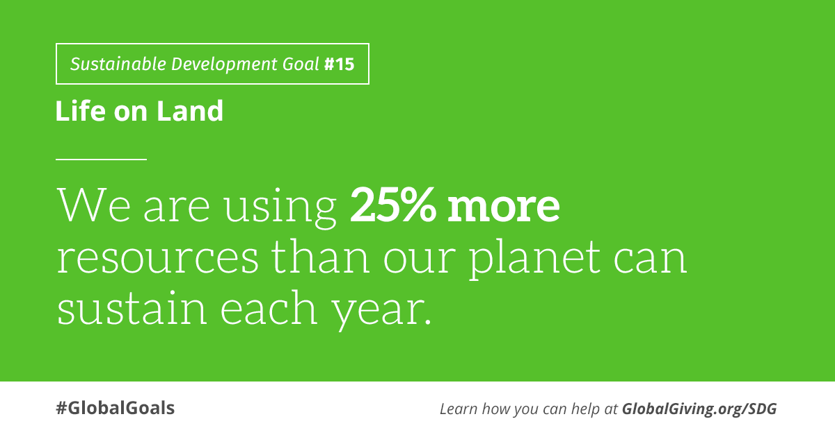
Life on land
According to estimates from organizations such as the International Union for Conservation of Nature (IUCN), thousands to tens of thousands of species are on the brink of extinction or have already become extinct each year
Biodiversity conservation: Effective waste management can reduce threats to land and terrestrial biodiversity. The pollution and destruction of land and biological habitats by garbage may lead to species extinction, ecosystem collapse, and decreased biodiversity.
Land pollution control: Improper garbage disposal can lead to land pollution, affecting soil quality and ecosystem function. Proper garbage management can reduce land pollution and protect the health and function of land ecosystems.
Habitat protection and restoration: Waste management can help protect and restore the habitats of terrestrial organisms. Measures such as clearing polluted land, restoring damaged ecosystems, and establishing protected areas can promote the survival and reproduction of terrestrial organisms.

Slide 11
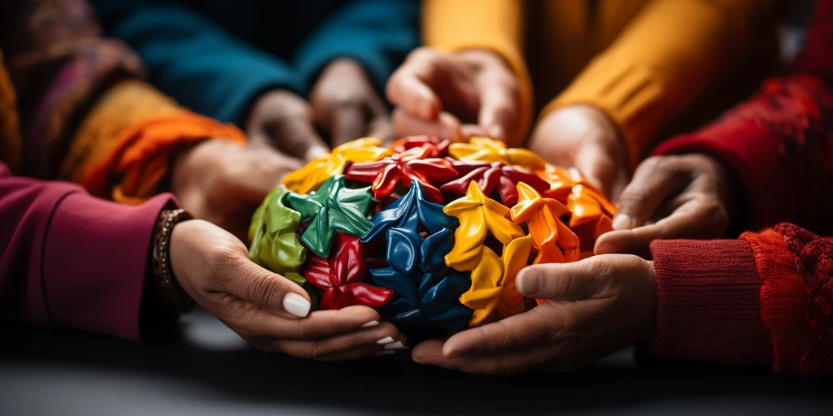
Quality education
Education is the key to changing the future.
We not only need to know the importance of sustainable development ourselves, but also need to make more people, our next generation, aware of the importance of sustainable development.

Slide 12
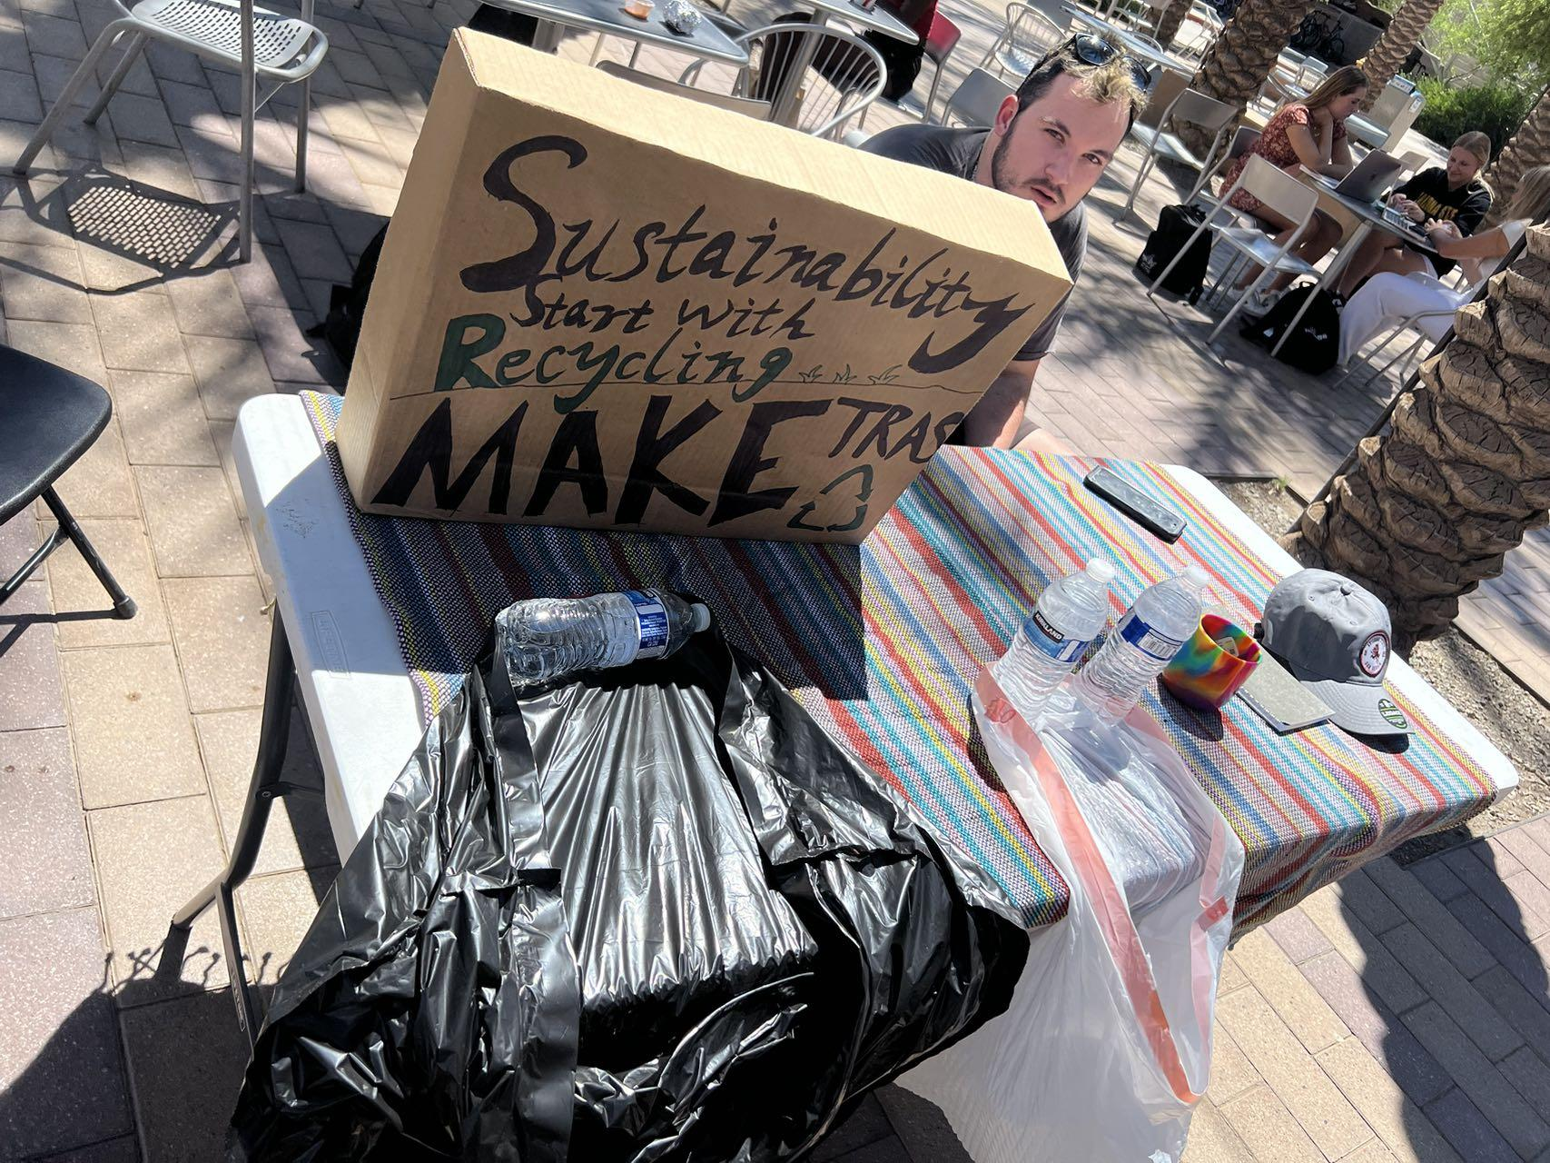
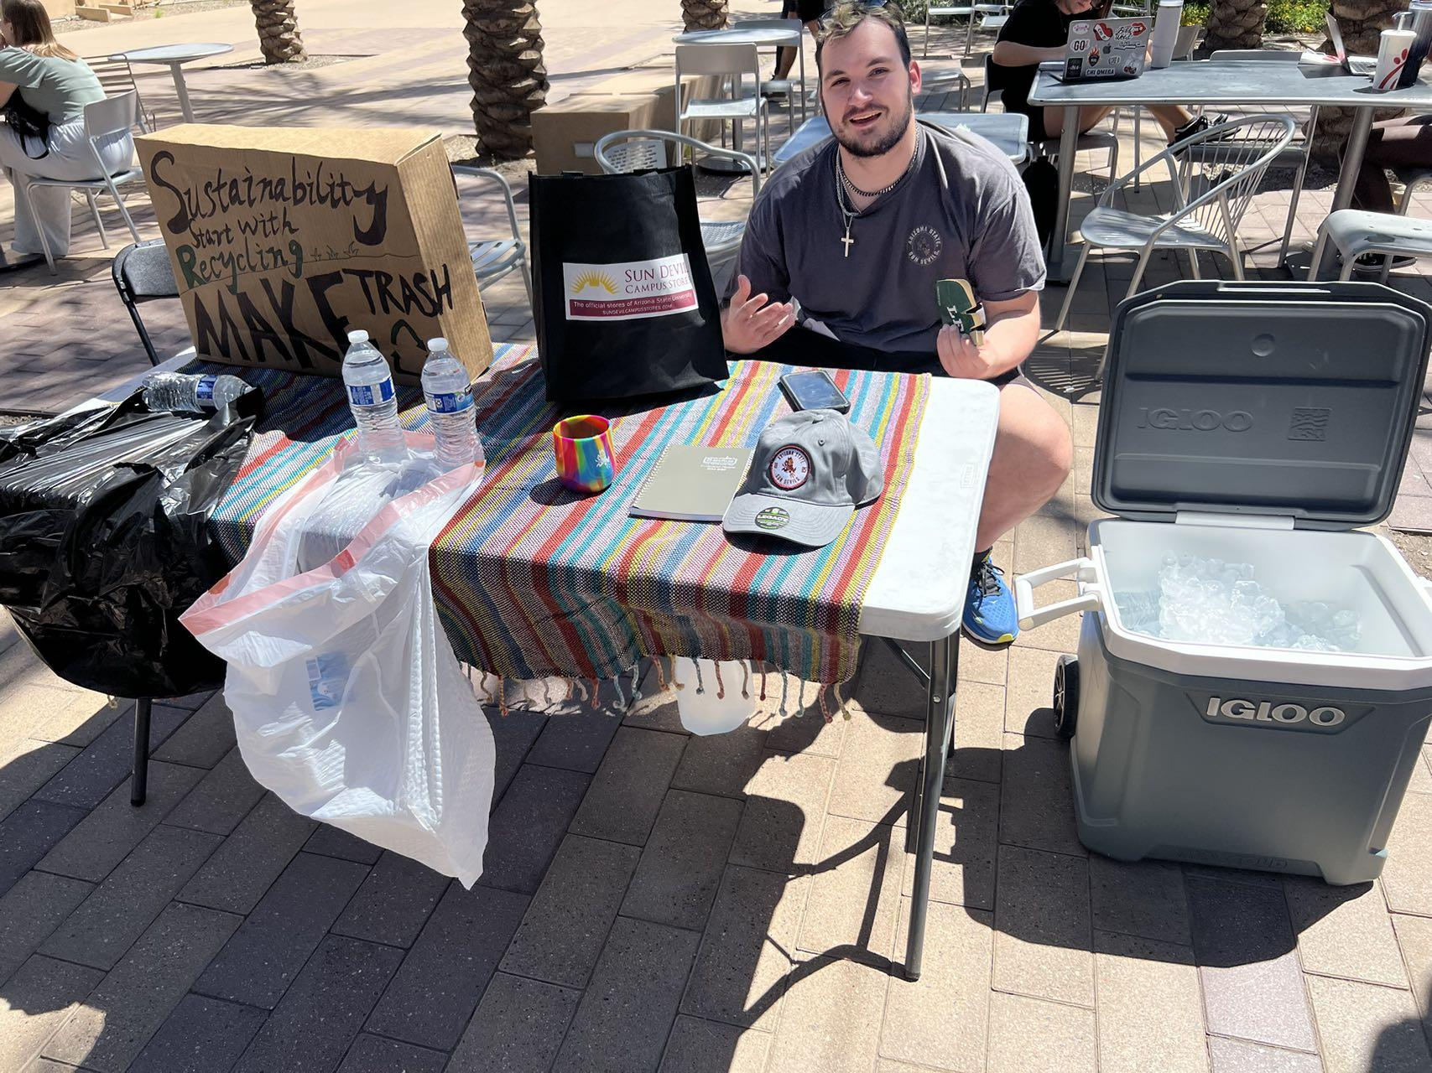
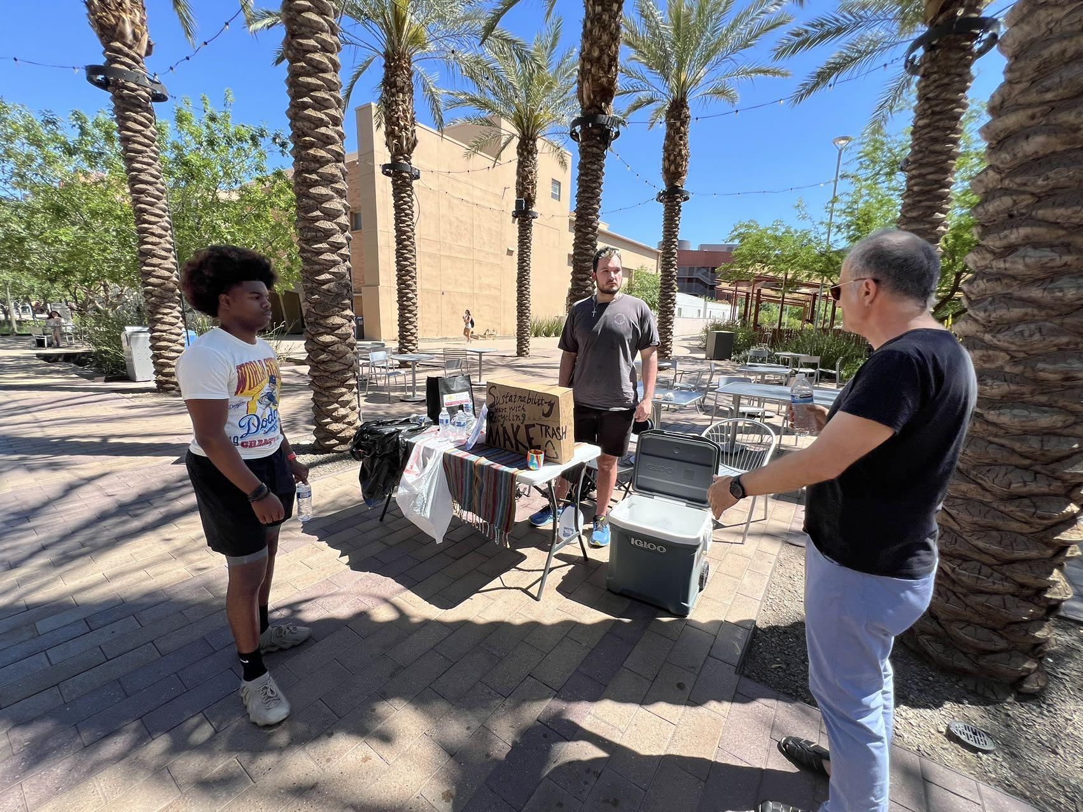
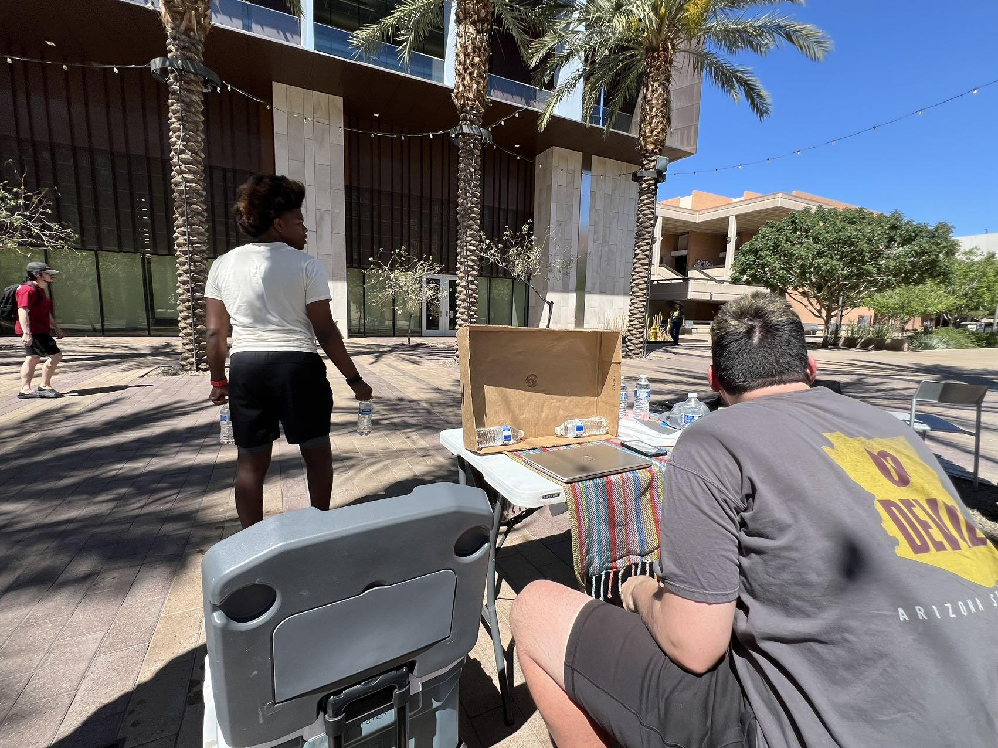
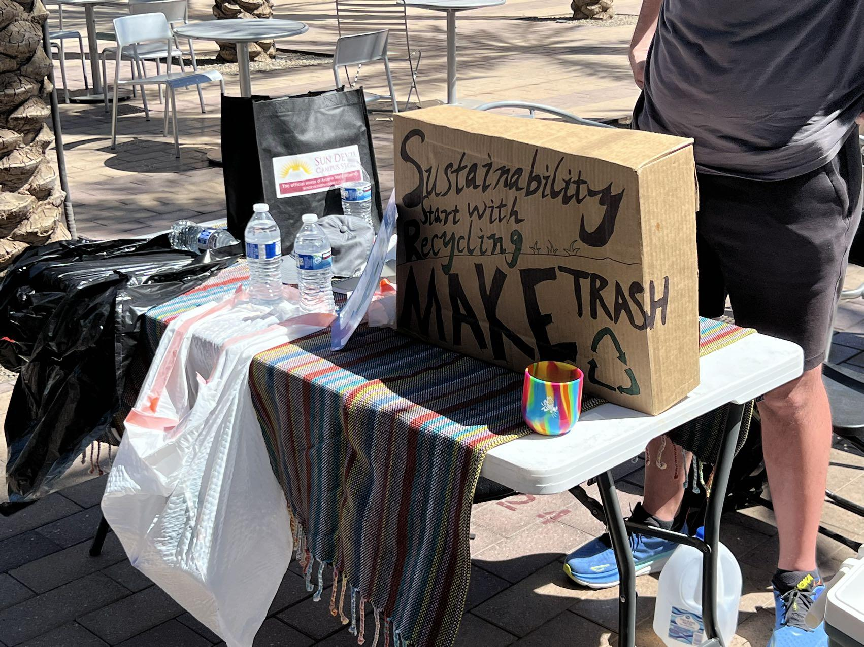
What We Do

Slide 13
Conclusion
Oceanness is a clothing brand that has a purpose-driven apparel brand, created to save the ocean. From eco-friendly apparel made from recycled plastic bottles, to removing plastic waste from the ocean and coastlines, everything we do is for the love of our ocean. Oceanness provide sustainable clothes made from recycled plastic bottles, and jewelry made from ocean plastic collected on the shores of Oslo and Grimstad. For every item sold, we collect 2 kg plastic waste, equivalent to 100 plastic bottles, from the ocean and coastlines in partnership with Plastic Bank. Our mission is simple - to save the ocean by having the world

Slide 14
Conclusion Part 2
6 Step Plan

Slide 15
The End

